Slide 1

ACTING LIKE A DESIGNER
CHAPTER 07

Slide 2
Topics
The Iterative Process of Design
  Analysis
  Design
  Implementation
  Testing
  Iteration!
Innovation
Brainstorming and Ideation
Changing Your Mind
Professional Development Phases
Scoping

Slide 3
The Iterative Process of Design
"Game design is 1% inspiration
and 99% iteration"
  – Chris Swain

Slide 4
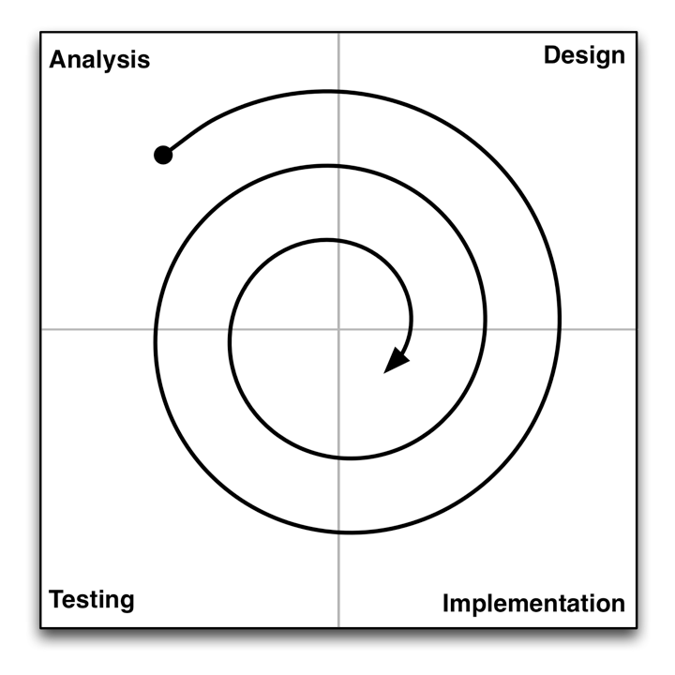
The Iterative Process of Design
Analysis
  Understand where you are and what you want to accomplish
  Think about your available resources and time

Slide 5
The Iterative Process of Design
Design
  Create a design that solves the problem or fits the opportunity
  Starts with brainstorming. Ends with a plan for implementation.

Slide 6
The Iterative Process of Design
Implementation
  Execute on your plan. Make a working game prototype.
  What is the shortest path to something playable / testable?

Slide 7
The Iterative Process of Design
Testing
  Have people actually play your game and get reactions!
  Testing is critically important to this process!

Slide 8
The Iterative Process of Design
Iteration!
  Analyze the results of your game testing
  Modify your design, implement, test again!

Slide 9
The Iterative Process: Analysis
Analysis is about asking the right initial questions
  For whom are you designing this game?
    Demographic information
    Target platform
    You're almost never designing the game for yourself!
  What are your resources?
    Team members, budget, timeline
    Time is the most important resource!
  What prior art exists?
    What other games exist in this space?
    This is often ignored by novice designers, but it's critically important!
  What is the fastest path to a playable and testable game?
    How can you get your game up and running ASAP?
    Mechanics are absolutely the most important element in this phase

Slide 10
The Iterative Process: Design
A lot of design is about having an attitude of listening
  Listen to your audience
    Think about your audience when designing a game
    Listen to their feedback when you get it
  Listen to your team
    Listen to the other people who are working with you
      Especially when they disagree with you
  Listen to your client
    If someone is paying you to design a game, you need to listen to them
    This often makes them more likely to pay you and hire you again
  Listen to your game
    Some brilliant ideas just don't fit in the game you're currently designing
    Save these for later

Slide 11
The Iterative Process: Design
A lot of design is about having an attitude of listening
  Listen to yourself
    Listen to your gut – Sometimes you'll get a gut feeling about something before you consciously figure it out
    Listen to your health – Take care of yourself and stay healthy
      Pulling all-nighters and stressing out decreases your creativity
      Eat well and exercise
      Take breaks when you need to
    Listen to how you sound to other people
      When you say things out loud, think about how you're coming across
      Do you sound respectful?
      Do you sound like you care about the other person?
      People who demonstrate care and respect for others tend to do better in life, especially in creative fields

Slide 12
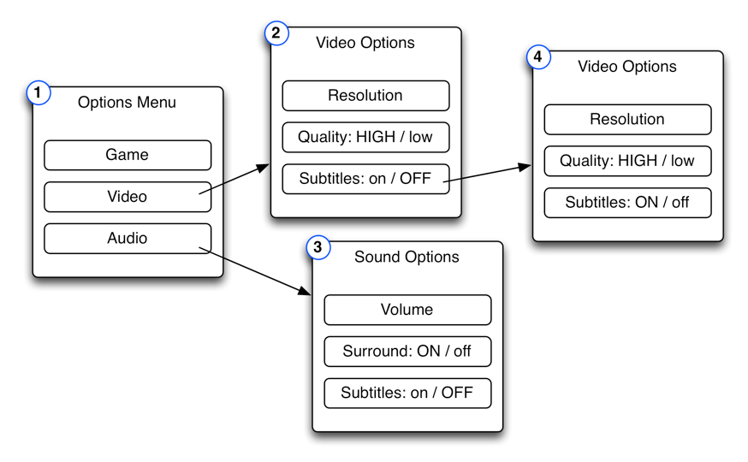
The Iterative Process: Implementation
The goal of implementation is to get from design to testing as quickly and efficiently as possible
  Sometimes you don't even have to make a digital prototype
    For GUI (Graphical User Interface) testing, sometimes a paper prototype will do just fine
    Make pages showing various states of your menu system and test them on people
This is a paper GUI prototype for asking the player how to turn on subtitles

Slide 13
The Iterative Process: Implementation
The goal of implementation is to get from design to testing as quickly and efficiently as possible
  Sometimes you don't even have to make a digital prototype
  When making digital prototypes, focus on the Mechanics
    The most important thing to test in a digital game is usually the Mechanics
    The Mechanics are also the inscribed element that can't be tested by other means
    The Technology of your prototype will often be replaced by production code in the future

Slide 14
The Iterative Process: Testing
You won't know anything about your game until someone else plays it
  Because you are the designer, your view of the game is drastically biased
  You need other people to play the game and give you feedback
  People will often try not to hurt your feelings
    Schell recommends saying "I need your help. This game has some real problems, but we’re not sure what they are. Please, if there is anything at all you don’t like about this game, it will be a great help to me if you let me know."

Slide 15
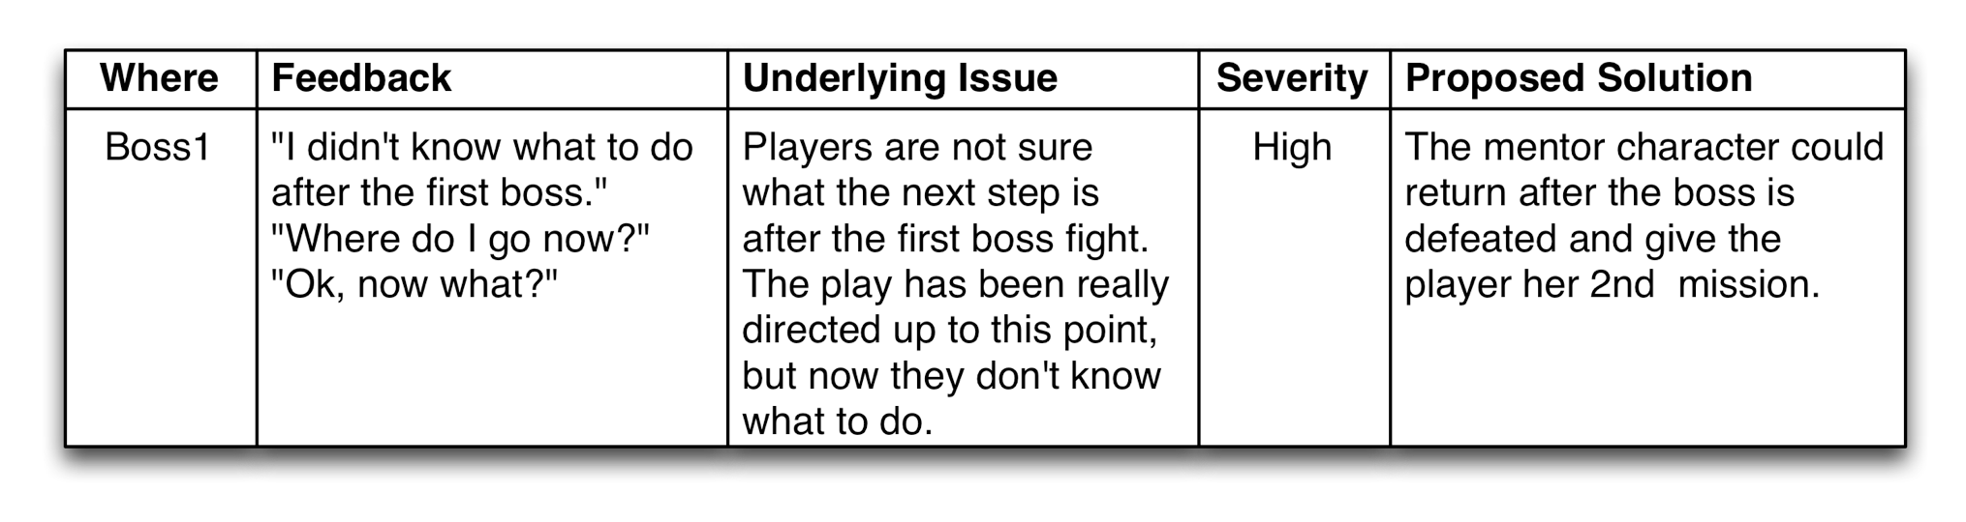
The Iterative Process: Testing
Take good notes!
  Where did the comment happen?
  What did the playtester actually say?
  What do you think she meant?
  How severe is the issue?
    Not all issues can be fixed
  What is your proposed solution?

Slide 16
The Iterative Process: Iteration
After testing, analyze the feedback and iterate!
Most games will go through this process many times
Board game projects at USC were four weeks long
  Week 1: Students are assigned to teams of four people
  Week 2: Students arrive in lab with a playable game
    The game is tested by various players for two hours
  Week 3: Students bring a 2nd iteration of the game to lab
  Week 4: Students bring a 3rd iteration of the game to lab
    Then students had a weekend to finalize the game and turn it in
Even for a student board game project, we iterated on the game four times before it was turned in
  Digital games take much more iteration!

Slide 17
Innovation
In The Medici Effect, Frans Johansson writes about two kinds of innovation:
  Incremental - Making something slightly better
    Example: The improvements in the Pentium chip in the 1990s
    Pros: Easy to convince investors that it will work, Predictable
    Cons: Only a slight innovation, Nothing revolutionary, Predictable
  Intersectional - The combination of two different ideas
    Example: Magic: The Gathering combined card games and collecting
    Pros: Has the potential to create something new and exciting
    Cons: High chance of failure, People won't believe it 'till they see it
Johansson believes that the innovation in the renaissance was a result of the intersection of Eastern and Western cultures due to increased trade

Slide 18
Brainstorming and Ideation
"The best way to have a good idea
is to have a lot of ideas and
throw out all the bad ones."
  – Linus Pauling
      Pauling is the only person to have won both the Nobel Prize in Chemistry and the Nobel Peace Prize as an individual.

Slide 19
Brainstorming and Ideation
This brainstorming process is based on intersectional innovation
It has worked well in both large and small groups
Five Steps:
  Step 1: Expansion
  Step 2: Collection
  Step 3: Collision
  Step 4: Rating
  Step 5: Discussion

Slide 20
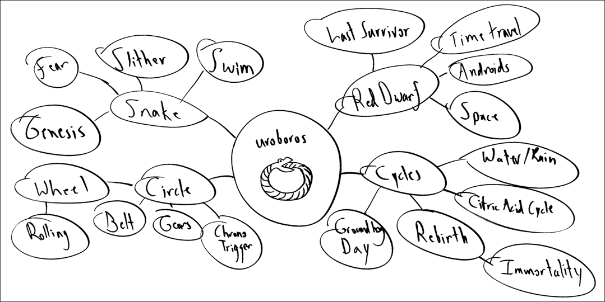
Brainstorming and Ideation
Step 1: Expansion
  Start with the core theme of your brainstorm in the middle of a whiteboard
  Create as many ideas as possible around it
  Don't censor at all in this phase

Slide 21
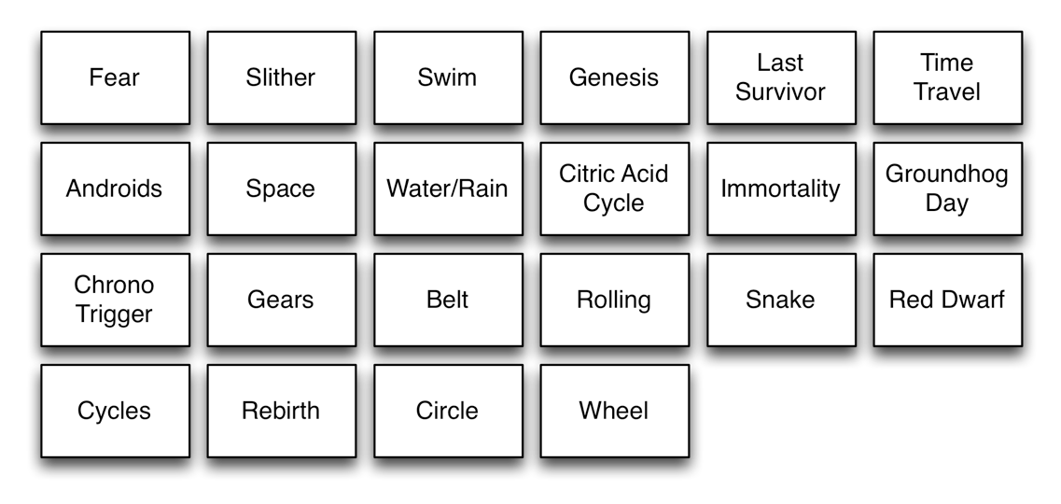
Brainstorming and Ideation
Step 2: Collection
  Write down each node of the expansion phase on a 3x5 note card or a Post-it note
  These are "idea cards"

Slide 22
AN ASIDE ABOUT JOKES
    Two lithium atoms are walking along.
    One says to the other, "Phil, I think I lost an electron back there."
    So Phil says, "Really Jason, are you sure?"
    And Jason replies, "Yeah, I'm positive!"
Jokes (even bad jokes) are another form of intersectional innovation
  Your brain is thinking in one direction and then is forced to make a connection between that and something unrelated
  There is joy in that connection, which we perceive as humor
Creating new, innovative ideas is pleasurable in the same way

Slide 23
Brainstorming and Ideation
Step 3: Collision
  Shuffle all the idea cards together
  Deal two to each person in the group
  Each person takes the two idea cards up to the whitboard and reveals them to the group
  The group collectively comes up with three game ideas inspired by the collision of the two cards
  Again, don't censor too much in this step

Slide 24
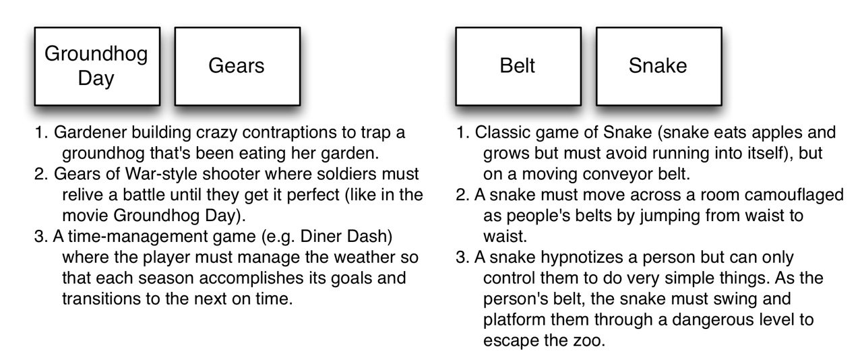
Brainstorming and Ideation
Step 3: Collision
  Examples:

Slide 25
Brainstorming and Ideation
Step 4: Rating
  Each person should pick the two ideas from Step 3 that she feels have the most merit and write them on the whiteboard
  If someone has already written one of your top ideas, just write your 3rd choice
  Wait for everyone to finish doing this
  Then, each person in the group should simultaneously put a mark on the board next to the three ideas that they like the most
    Some ideas will have many marks next to them, while others will have only a few

Slide 26
Brainstorming and Ideation
Step 5: Discussion
  Given the information from Step 4, start discussing ideas
  Start with the most popular ideas, but don't be afraid to mix in some of the other ideas as well
  Combine the best ideas into something really great!

Slide 27
Changing Your Mind
No one every goes directly from idea to game
X
Idea
Game

Slide 28
Changing Your Mind
The real process involves a lot of iteration and changing your mind
Prototype
Idea
Prototype
Game
Game
Prototype
Prototype
And you finish with a much better design than your initial game idea!
Game

Slide 29
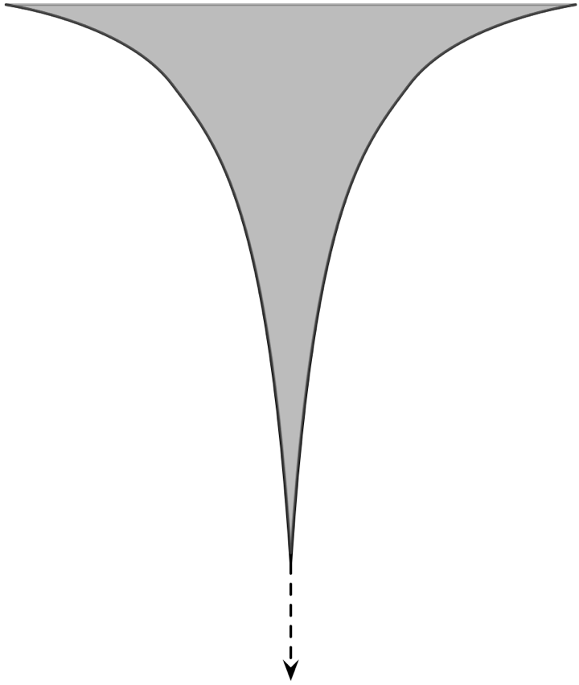
Changing Your Mind
However, as the project moves through development phases, you're more locked in to decisions
    Big Changes
    Preproduction
    Production
    Alpha
    Beta
    Small Changes
    Gold
    Post-Release

Slide 30
Professional Development Phases
Preproduction
  Small team (4-16 people)
  Lots of prototyping, lots of changes to ideas
  Lots of playtesting by a trusted audience
  The topic of most of this book
  Ends in a high-quality "vertical slice" of the game
Production
  Massive team growth (up to 100-300 people)
  Systems design needs to be locked down very quickly
  Changes cost a lot more, so there are fewer changes
  Expands the vertical slice quality to the rest of the game
  Playtesting continues (somewhat expanded audience)

Slide 31
Professional Development Phases
Alpha
  Functionality and game mechanics are 100% locked
  No more changes to the systems design of the game
  Only make changes in response to specific problems found through testing
  Extensive QA (Quality Assurance) testing in this phase by professional QA teams
  Some bugs (errors in programming) remain, but all should have been identified
  Alpha ends when you believe that all high-level bugs have been resolved

Slide 32
Professional Development Phases
Beta
  The game is effectively done
  Only minor bugs remain
  Purpose of this phase is to find and fix any remaining bugs
  No design changes, just fixes
  Lots of testing!
Gold
  The game is ship-ready
Post-Release
  In the Internet age, games can have a post-release phase
  A little bug-fixing for very rare bugs (encountered by players)
  DLC (DownLoadable Content) production

Slide 33
Scoping
Overscoping is the #1 killer
of game projects.

Slide 34
Scoping
Scoping is the process of limiting your design to what can be reasonably accomplished with the time and resources you have available
Most AAA professional games have
  Teams of hundreds of people
  Budgets of millions of dollars
  A two-year development timeline
Think realistically about what you have available when making your games
Look to independent game festivals like IndieCade for inspiration
  Even some indie games have large teams and budgets

Slide 35
Chapter 7 – Summary
The Iterative Process of Design is the key to good design
Great innovations can come from combining disparate ideas
  A good brainstorming process can help you do this
Prototypes exist to help you hone your designs
But you can only make major design changes early in the game development process
Carefully consider the scope of your game design!
Next Chapter:
  We explore several goals that you can have as a designer

